Slide 1

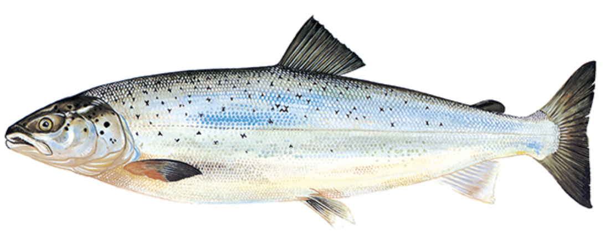
Aquaculture production
Salmon production
Trout production
Sustainability indicators :
Lice
prevalence
MOM B
investigations
Economic feed
conversion ratio
Escaped fish
1.3

Slide 2
